Slide 1
A CRM APPLICATION FOR SCHOOL/COLLEGES
TEAM LEADER SNEHA.M
MEMBERS 1 SOWMIYA M
2 SUGANYA M
3 SUBASHINI A

Slide 2
INTRODUCTION
1.1 OVERVIEW
An Education Customer Relationship Management Software Manages All Your Institution’s Interactions With Prospective And Current Students. It Also Supports Managing Communications With Alumni, employees, donors and other Members Of The Education Sector In Your Institution.
1.2 PURPOSE
A CRM Tool Lets You Store Customer And Prospect Contact Information, Identify Sales Opportunities, Record Service Issues, And Manage Campaign's All In One Central Location And Make Information About Every Customer Interaction Available To Anyone At Your Company Who Might Need It.

Slide 3
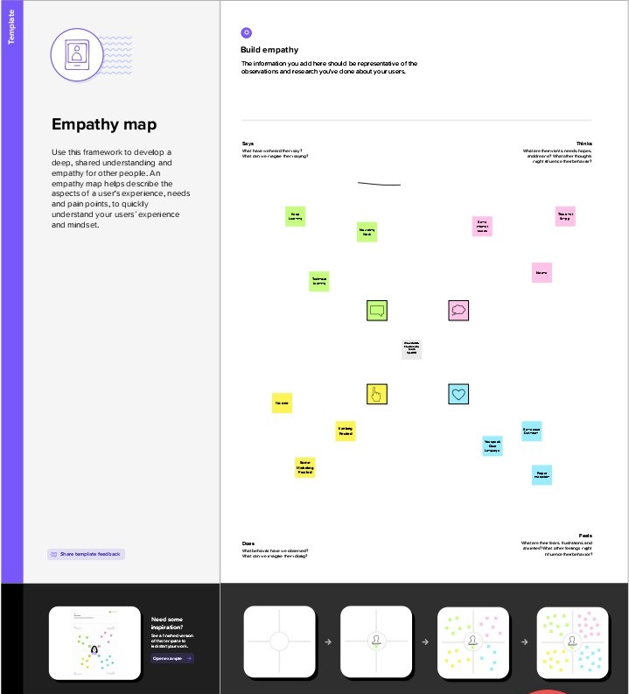
2 PROBLEM DEFINITION & DESIGN THINKING
2.1 EMPATHY MAP

Slide 4
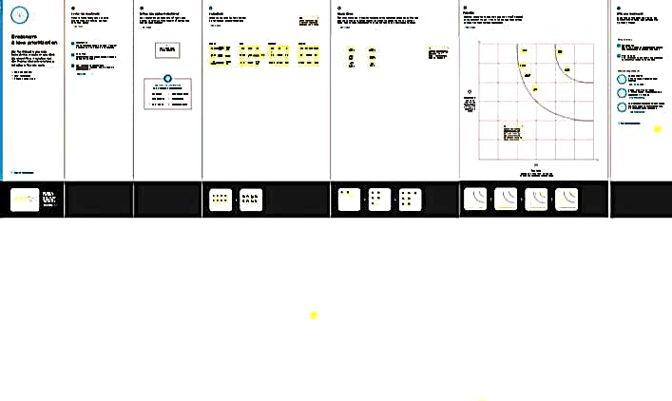
2.2 BRAINSTORMING

Slide 5
3 result
3.1 DATA MODEL
Object Name | Field In The Object
Obj1 School management
Obj2 Field for school
Field Label | Data Type
school | custom
students | custom
Field label | Data type
Enter address | Area text
Enter phone number | phone

Slide 6
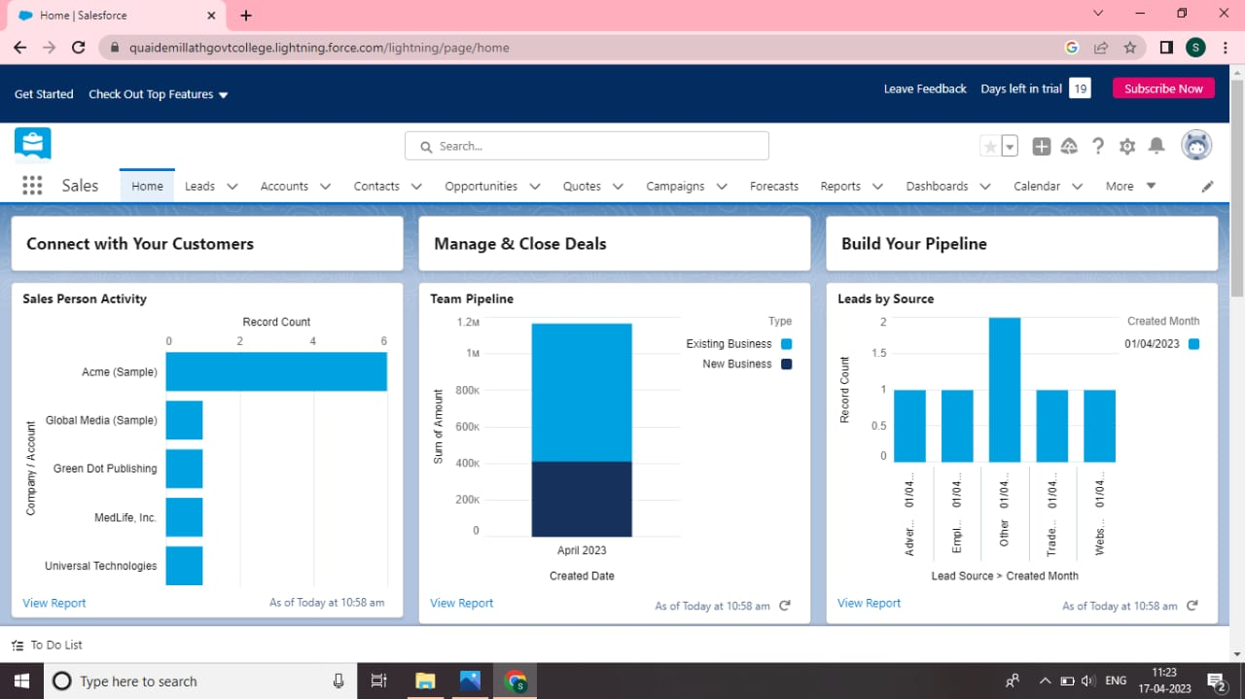
3.2 ACTIVITY & SCREENSHOT

Slide 7
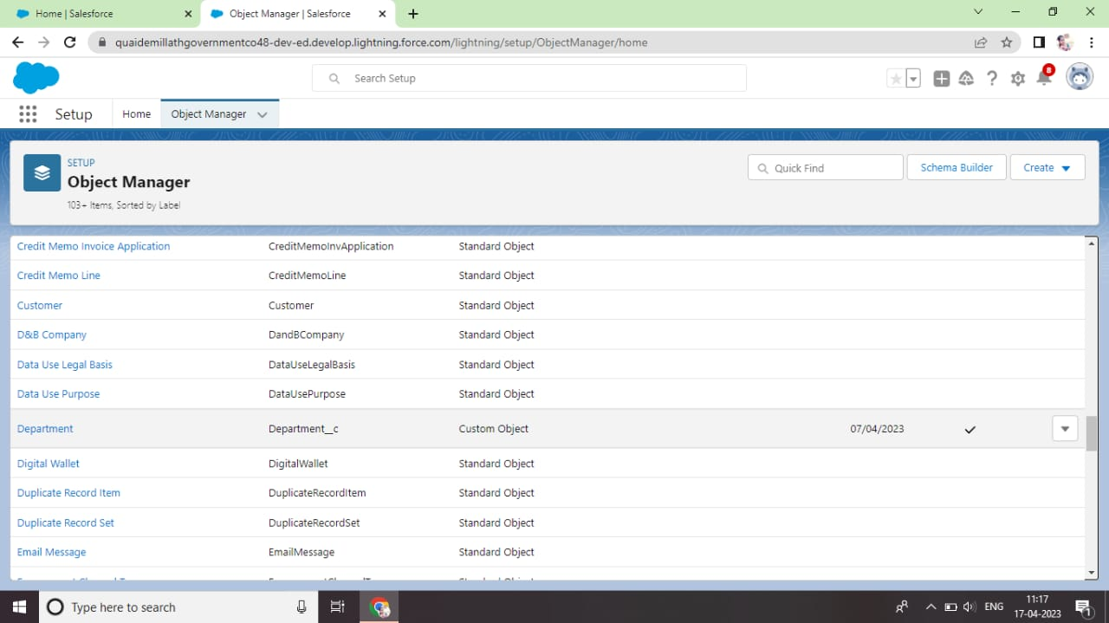

Slide 8
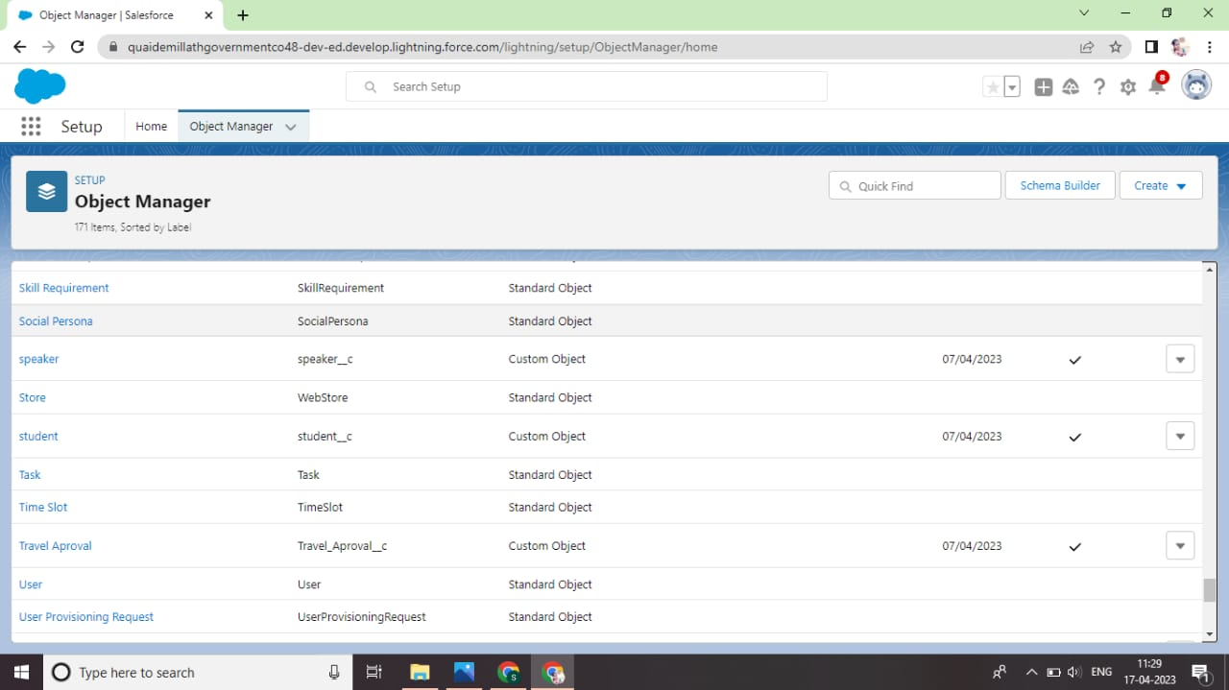

Slide 9
4 TRAILHEAD PROFILE PUBLIC URL
Team Lead – https://trailblazer.me/id/sneha4s
Team Member 1-https://trailblazer.me/id/sowmiyaraji
Team Member 2-https://trailblazer.me/id/subha44
Team Member 3-https://trailblazer.me/id/suganya4s
5 ADVANTAGES
Improved Information Organization.
CRM For Enhanced Communication.
Automation Of Everyday Tasks.
Improved Analytical Data Ana Reporting.

Slide 10
6 Disadvantages
A Costly Project.
Loss Of Collected Information Or Record.
Not Suitable For Every Business.
It Eliminates The Human Element.
applications
Customer Relationship Management Is A Set Of Integrated, Data Driven Software Solution That Help Manage, Track, And Store Information Related To Your Company’s Current And Potential Customers.

Slide 11
8 conclusion
customer relationship management enables a company to align its strategy with the needs of the customer in order to best meet those needs and thus ensure long term customer loyalty.
Future scope
The Future Of Crm Is About Which Companies Will Be Able To Pivot To Meet The Changing Needs And Trends Driven By Customer Expections. Customers Expect Organizations To Know A Lot About Them And Expect To Have Conversation.

